Slide 1
Unemployment Rate Analysis
Maddie Massie, Asma Sadia

Slide 2
Research Questions
How has unemployment rate change in the last five years?
How does race affect unemployment?
How does gender affect unemployment?
How does education level affect unemployment?

Slide 3
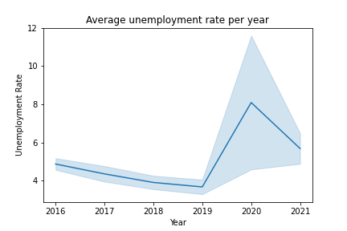
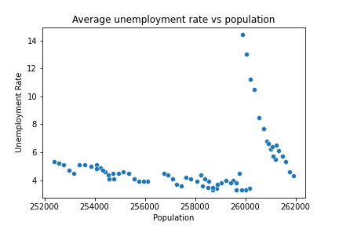
Average Unemployment Rate

Slide 4
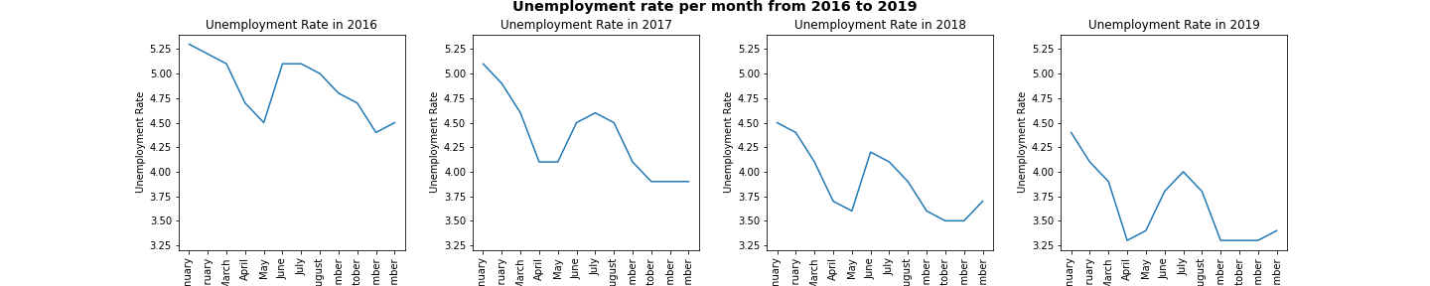
Unemployment Rate Each Year

Slide 5
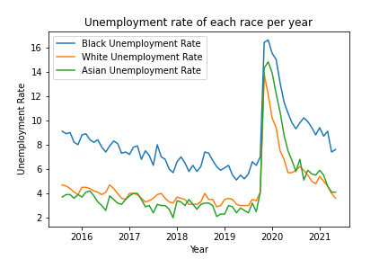
Unemployment Rate by Race

Slide 6
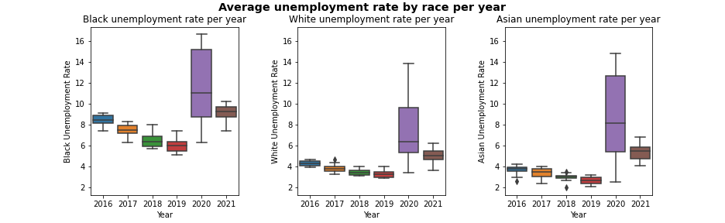
Average Unemployment Rate by Race

Slide 7
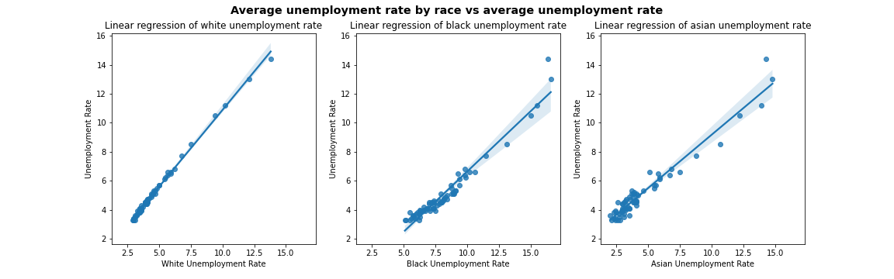
Linear Regression by Race
Correlation = .998
Correlation = .971
Correlation = .974

Slide 8
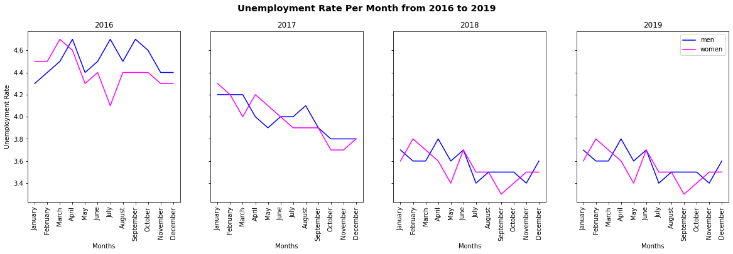
Gender

Slide 9
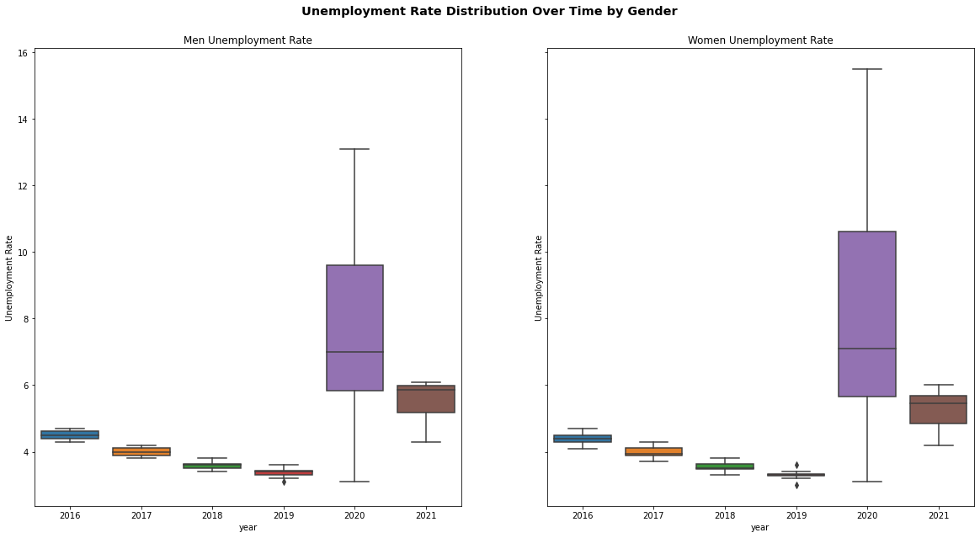
Gender

Slide 10
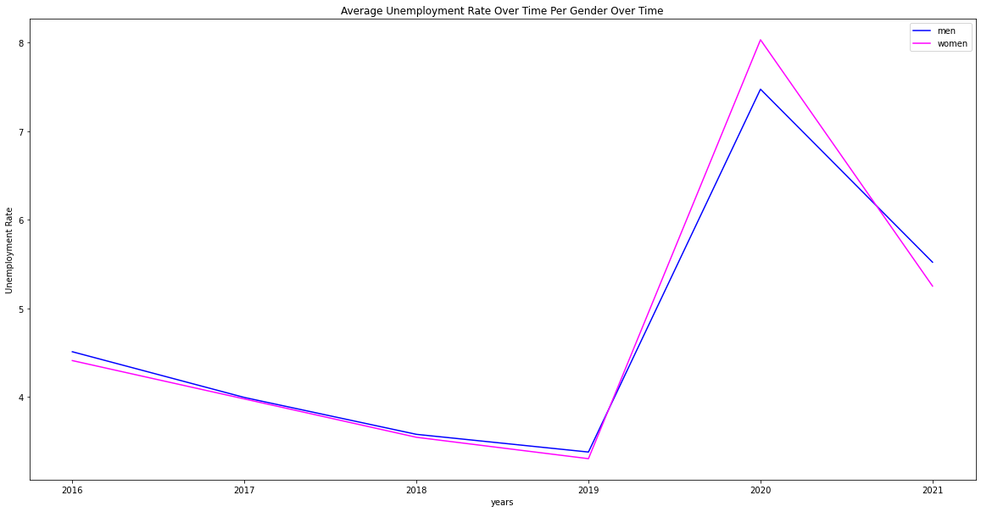
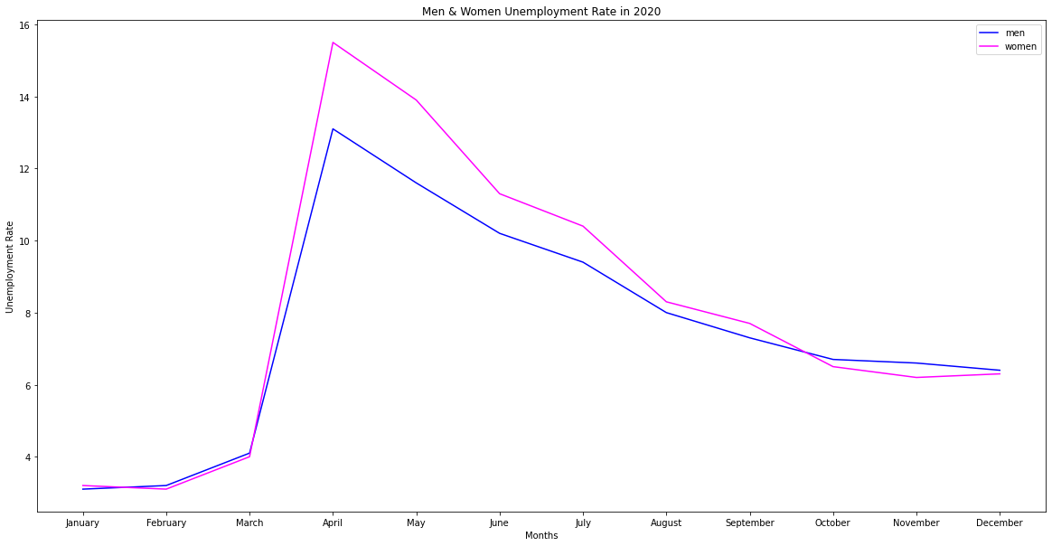
Gender

Slide 11
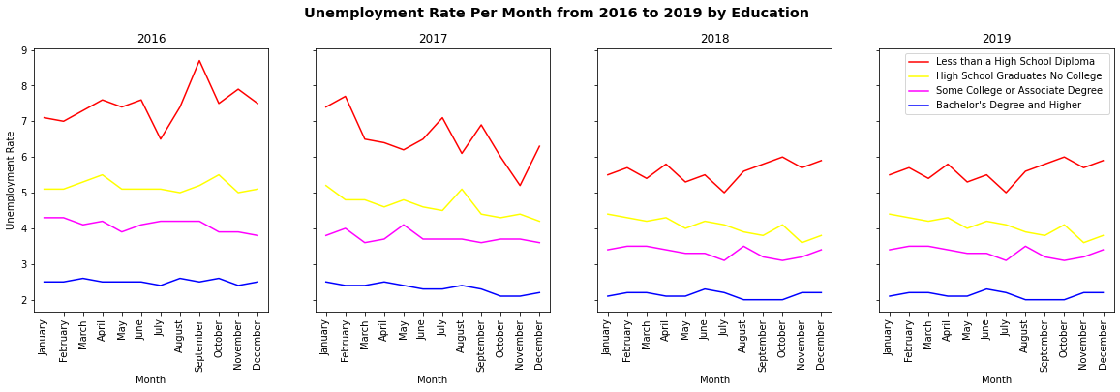
Education

Slide 12
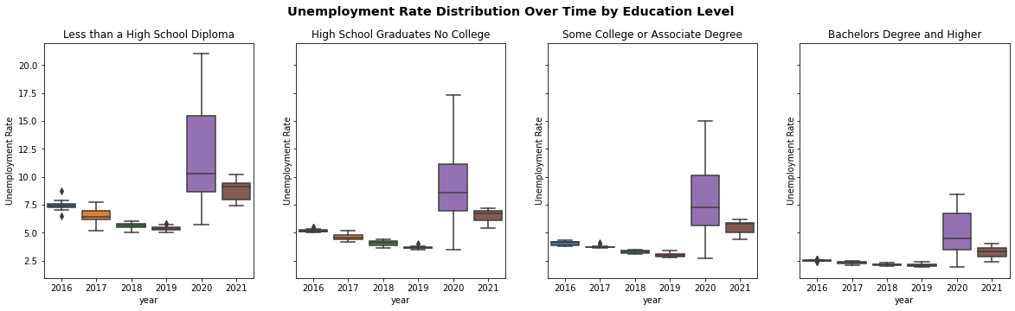
Education

Slide 13
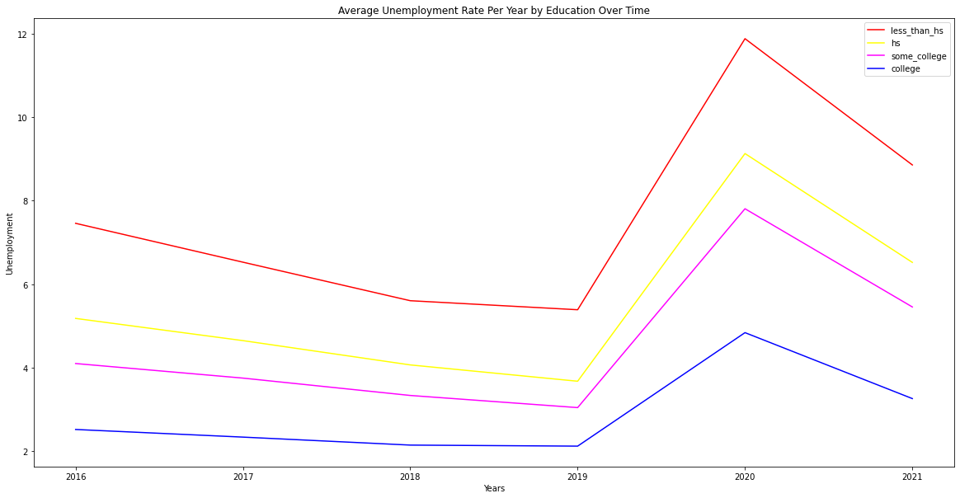
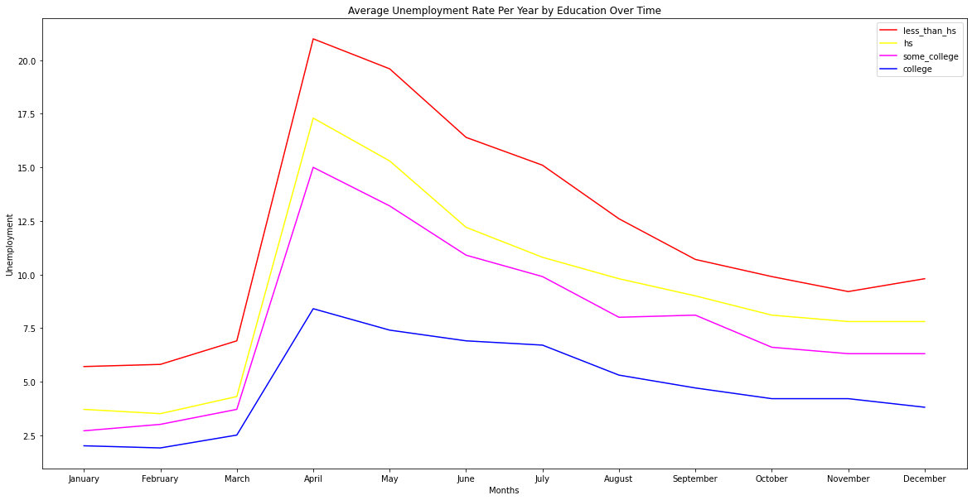
Education

